Slide 1
Uncertainty in Modeling

Slide 2
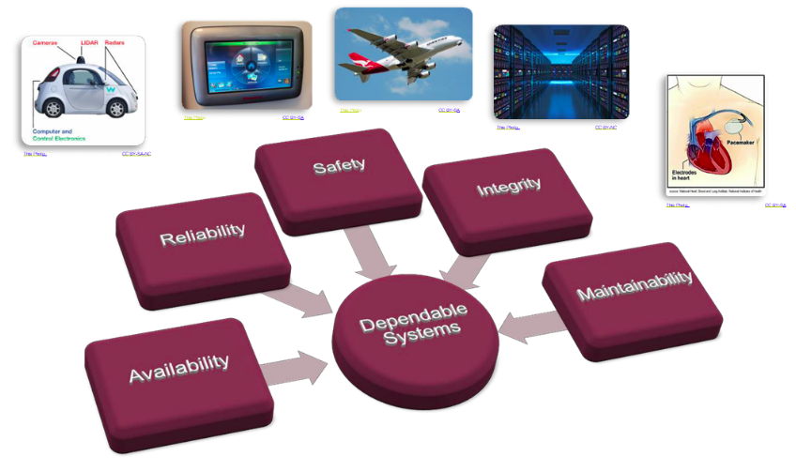
Dependable Systems
Dependable Systems can be found in many forms and application domains, but especially in transportation systems, medical systems and recently in the domain of IoT and Industry 4.0.*
*Industry 4.0 has been defined as “a name for the current trend of automation and data exchange in manufacturing technologies, including cyber-physical systems, the Internet of things, cloud computing and cognitive computing and creating the smart factory”

Slide 3
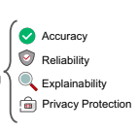
Dependable AI
Accuracy : The prediction accuracy is the basic ability of a trustworthy model. Trustworthy NNs are expected to generate accurate output, consistent with the ground truth, as much as possible;
Reliability: Trustworthy NNs should be resilient and secure. In other words, they must be robust against different potential threats, such as inherent noise, distribution shift, and adversarial attacks;
Explainability: The model itself must be explainable for the prediction, which can help humans to enhance understanding, make decisions and take further actions;
Privacy protection: Trustworthy NNs are required to ensure full privacy of the models as well as data privacy.

Slide 4
Pillars of Security
Confidentiality is satisfied if data or objects are not read by an unauthorized party.
Integrity is satisfied if data or objects are not changed (written) or generated by an unauthorized party.
Authenticity is satisfied if an author of data or an object is who it claims to be.
Availability is satisfied if data, objects, or services are available.

Slide 5
Can AI-based Components be Part of Dependable Systems?

Slide 6
Machine learning seeks to develop methods for computers to improve their performance at certain tasks on the basis of observed data.
Typical example:
detecting pedestrians in images taken from an autonomous vehicle,
classifying gene-expression patterns from leukaemia patients into subtypes by clinical outcome,
or translating English sentences into French.
scope of machine-learning tasks is even broader than these pattern classification or mapping tasks, and can include optimization and decision making, compressing data and automatically extracting interpretable models from data.

Slide 7
Data: The Treasure
Almost all machine-learning tasks can be formulated as making inferences about missing or latent data from the observed data [inference, prediction or forecasting]
Example :
Consider classifying people with leukaemia into one of the four main subtypes of this disease on the basis of each person’s measured gene-expression patterns. Observed data : pairs of gene-expression patterns and labelled subtypes, Unobserved or missing data: subtypes for new patients.
To make inferences about unobserved data from the observed data:
the learning system needs to make some assumptions
taken together these assumptions constitute a model.

Slide 8
Model
A model can be very simple and rigid [classic statistical linear regression model]
Model can be complex and flexible [llarge and deep neural network]
A model is considered to be well defined if it can make forecasts or predictions about unobserved data having been trained on observed data
if the model cannot make predictions it cannot be falsified, in the sense of the philosopher Karl Popper’s proposal for evaluating hypotheses, or as the theoretical physicist Wolfgang Pauli said the model is “not even wrong”).
Any sensible model will be uncertain when predicting unobserved data, uncertainty plays a fundamental part in modelling.

Slide 9
Choice of Models

Slide 10
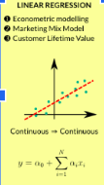

Rigid Linear Regression
Linear Regression is greatly affected by the presence of Outliers, linearity assumption
An outlier is an unusual observation of response y, for some given predictor x.
Logistic regression assumes linearity of independent variables and log odds.

Slide 11
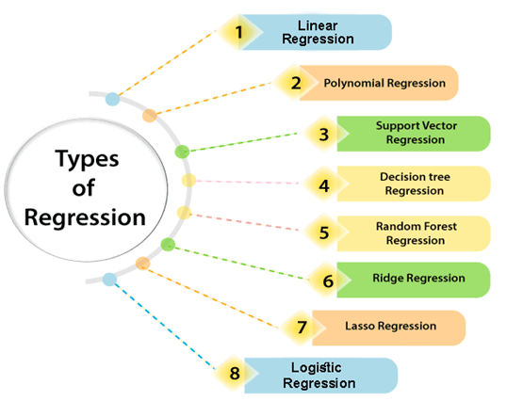




Regression analysis helps in the prediction of a continuous variable
Which model to choose?

Slide 12
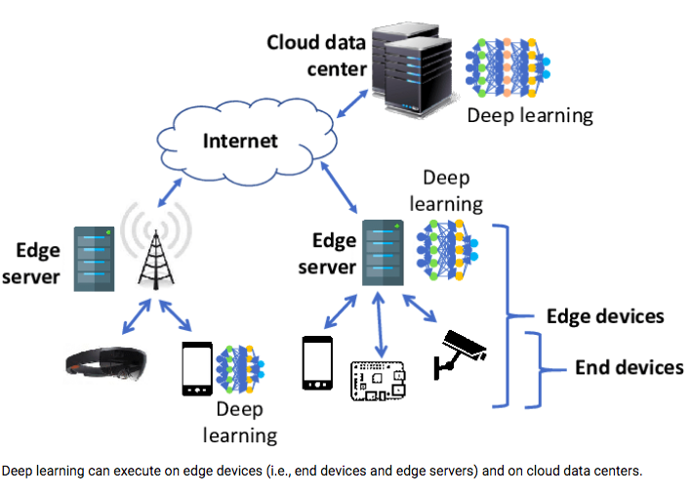
Flexible deep NN
DNNs is a challenge since they typically require billions of expensive arithmetic computations.
DNNs are typically deployed in ensemble to boost accuracy performance, which further exacerbates the system requirements.
This computational overhead is an issue for many platforms, e.g. data centers and embedded systems, with tight latency and energy budgets.
Flexible DNNs: achieves large reduction in average inference latency while incurring small to negligible accuracy drop

Slide 13
Problem 1: Uncertainty in Modelling

Slide 14
Uncertainty in Modelling
At the lowest level, model uncertainty is introduced from measurement noise, for example, pixel noise or blur in images.
At higher levels, a model may have many parameters, such as the coefficients of a linear regression, and there is uncertainty about which values of these parameters will be good at predicting new data.
Finally, at the highest levels : uncertainty about even the general structure of the model:
Is linear regression or a neural network appropriate, if the latter, how many layers should it have, and so on.

Slide 15
Probabilistic approach to modelling
uses probability theory to express all forms of uncertainty .
probability distributions are used to represent all the uncertain unobserved quantities in a model
structural, parametric and noise-related
how they relate to the data.

Slide 16
Probabilistic approach to modelling
basic rules of probability theory are used to infer the unobserved quantities given the observed data.
Learning from data occurs through the transformation of the prior probability distributions (defined before observing the data), into posterior distributions (after observing data).
The application of probability theory to learning from data is called Bayesian learning

Slide 17
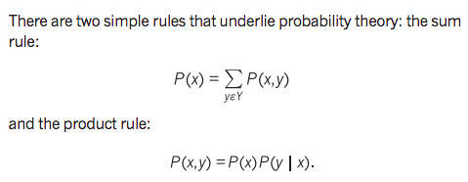
Bayesian machine learning: How to choose ?
x and y: observed or uncertain quantities, taking values in some sets X and Y, respectively.
For example, x and y might relate to the weather in Cambridge and London, respectively, both taking values in the set X=Y={rainy,cloudy,sunny}
P(x) : probability of x
P(x,y) is the joint probability of observing x and y,
P(y|x) is the probability of y conditioned on observing the value of x

Slide 18

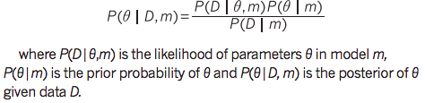
Bayesian machine learning: How to choose?*
Since P(x,y) and P(y,x) are commutative:
Apply probability theory to machine learning by replacing the symbols above:
Replace x by D to denote the observed data
Replace y by θ to denote the unknown parameters of a model
Ref: *https://www.nature.com/articles/nature14541.pdf

Slide 19
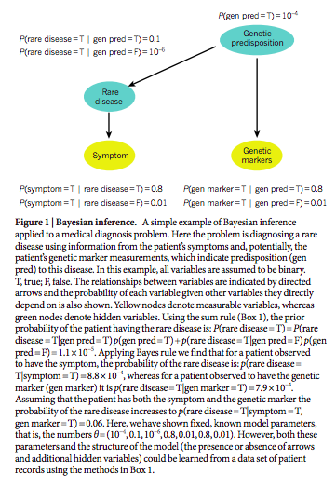
Compositional probabilistic models
Simple probability distributions over single or a few variables can be composed to form the building blocks of larger, more complex models.
Representing such compositional probabilistic models: graphical models

Slide 20
Problem 2: Overfitting of ML nets

Slide 21
Why Overfitting?
Overfitting is a modeling error in statistics that occurs when a function is too closely aligned to a limited set of data points
Example:
A traffic sign recognition system has to learn signs, but all STOP signs are only captured in an alley.
The ML algorithm is likely to learn, that a sign in an alley is a STOP sign and therefore detecting every traffic sign in an alley as such. Or a STOP sign, that is not located in an alley can not be detected.
This is caused by a low variance in the data, with a high bias

Slide 22
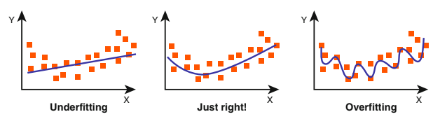
Overfitting underfitting details
A network is overfitting when a model’s training error (computed on a training set) is much lower than its generalization error (computed on a test or validation set).
This is opposite to underfitting, when a model is not able to obtain a sufficiently low error value on its training set.

Slide 23
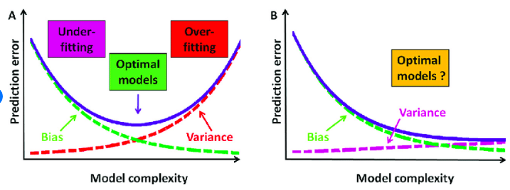
Bias is the difference between the average prediction of our model and the correct value which we are trying to predict.
Variance refers to the changes in the model when using different portions of the training data set [variance is the expectation of the squared deviation of a random variable from its population mean or sample mean.]

Slide 24
Problem 3: Edge Cases

Slide 25
Edge Cases
Unexpected scenarios that occur so irregularly or even seldom are called Edge Cases
often not covered in any training data, simply because they are not anticipated during the system development.
All can possibly lead to accidents, when the systems deals with them in a wrong way.
Example:
A vehicle that is only used in sunny weather for a long time in the same environment, will override some of the learned features trained by the manufacturer.
handling intersections and performing turns as well as crossing the intersection.

Slide 26
Solution
Learning algorithms could continue to evolve while in operation
this approach is also called continuous or on-the-fly learning.
Actually this approach is often seen as similar to human learning processes.
Drawback:
potentially unwanted behavior
the training can not be influenced in a suitable way
dynamic changes to a certified system in general is not permitted by the current regulations and standards

Slide 27
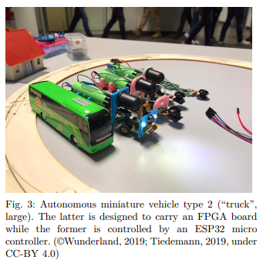
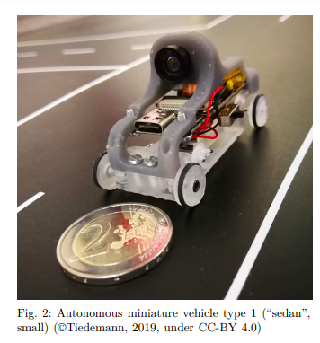
Test Case
To understand the implication of critical components based on machine learning, HAW Hamburg uses miniature vehicles
Testing on use cases:
obstacle detection for autonomous driving.
recognition of traffic signs
obstacles in the driving lane
route detection
Fault tree analysis

Slide 28
In Summary
Consider adversarial examples: small perturbations of input examples that make even a highly accurate ML model give incorrect predictions.
Adversarial examples can be used to regularize the training procedure and make a model robust to small perturbations of data (which is a special case of stability).
Adversarial examples can be used as explanations by providing the minimal changes in the input that would alter the model prediction on it (counterfactual explanations).
Adversarial examples that only change certain protected attributes like gender or race can be used to verify and optimize for fairness (fairness audit).

Slide 29
Refs
Torge Hinrichs, Bettina Buth:Can AI-based Components be Part of Dependable Systems? IV 2020: 226-231, https://ieeexplore.ieee.org/document/9304740
Reliable Machine Learning, https://www.microsoft.com/en-us/research/group/reliable-machine-learning/

